Slide 1
lab 6
Dr : Rasha
Eng : Gehad Mustaf

Slide 2
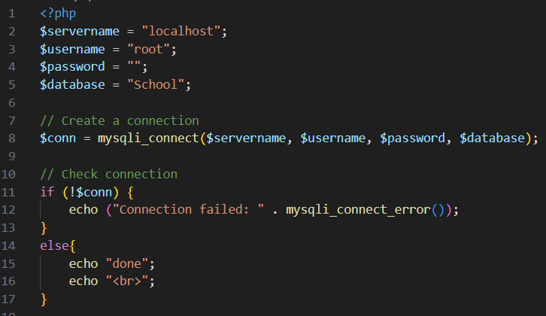
Open a Connection to MySQL

Slide 3
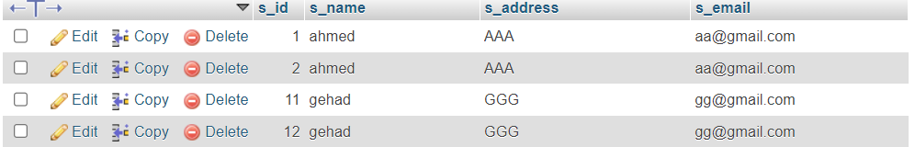
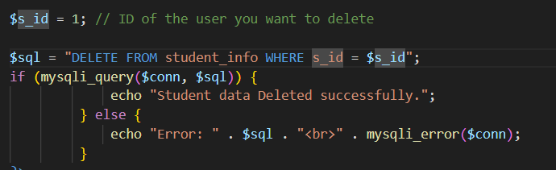

Delete from DB
Construct the SQL DELETE statement: Define the SQL DELETE statement to specify which records you want to delete from the database. You can use conditions to target specific rows.

Slide 4
Try
Try to receive the student ID from the user and delete the student.

Slide 5
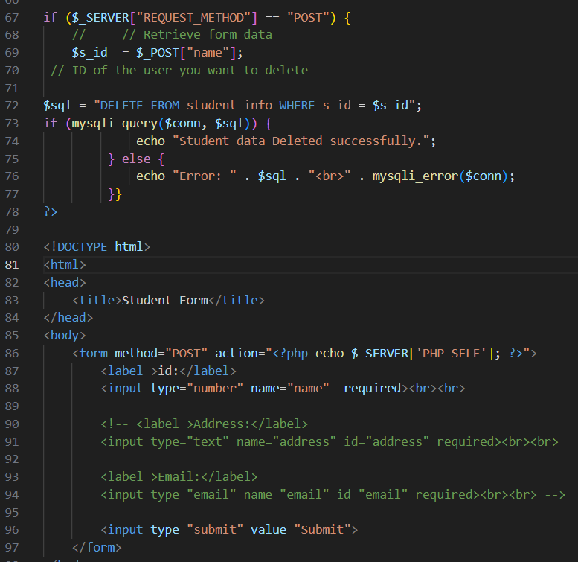

Slide 6
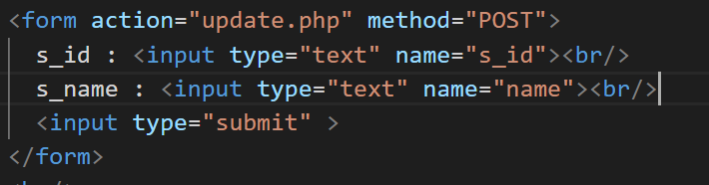
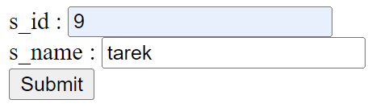
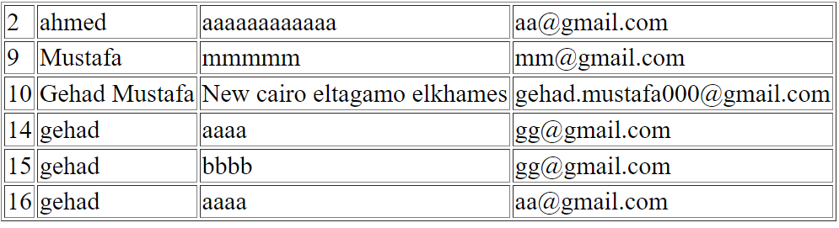
Update in DB

Slide 7
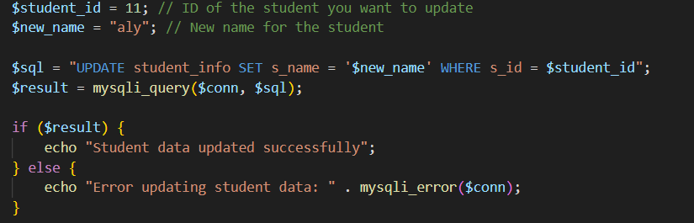
Update in DB

Slide 8
Try
Try to receive the student info from the user and update it.

Slide 9
Try
Try to select all students whose name is Gehad only.

Slide 10
